Slide 1
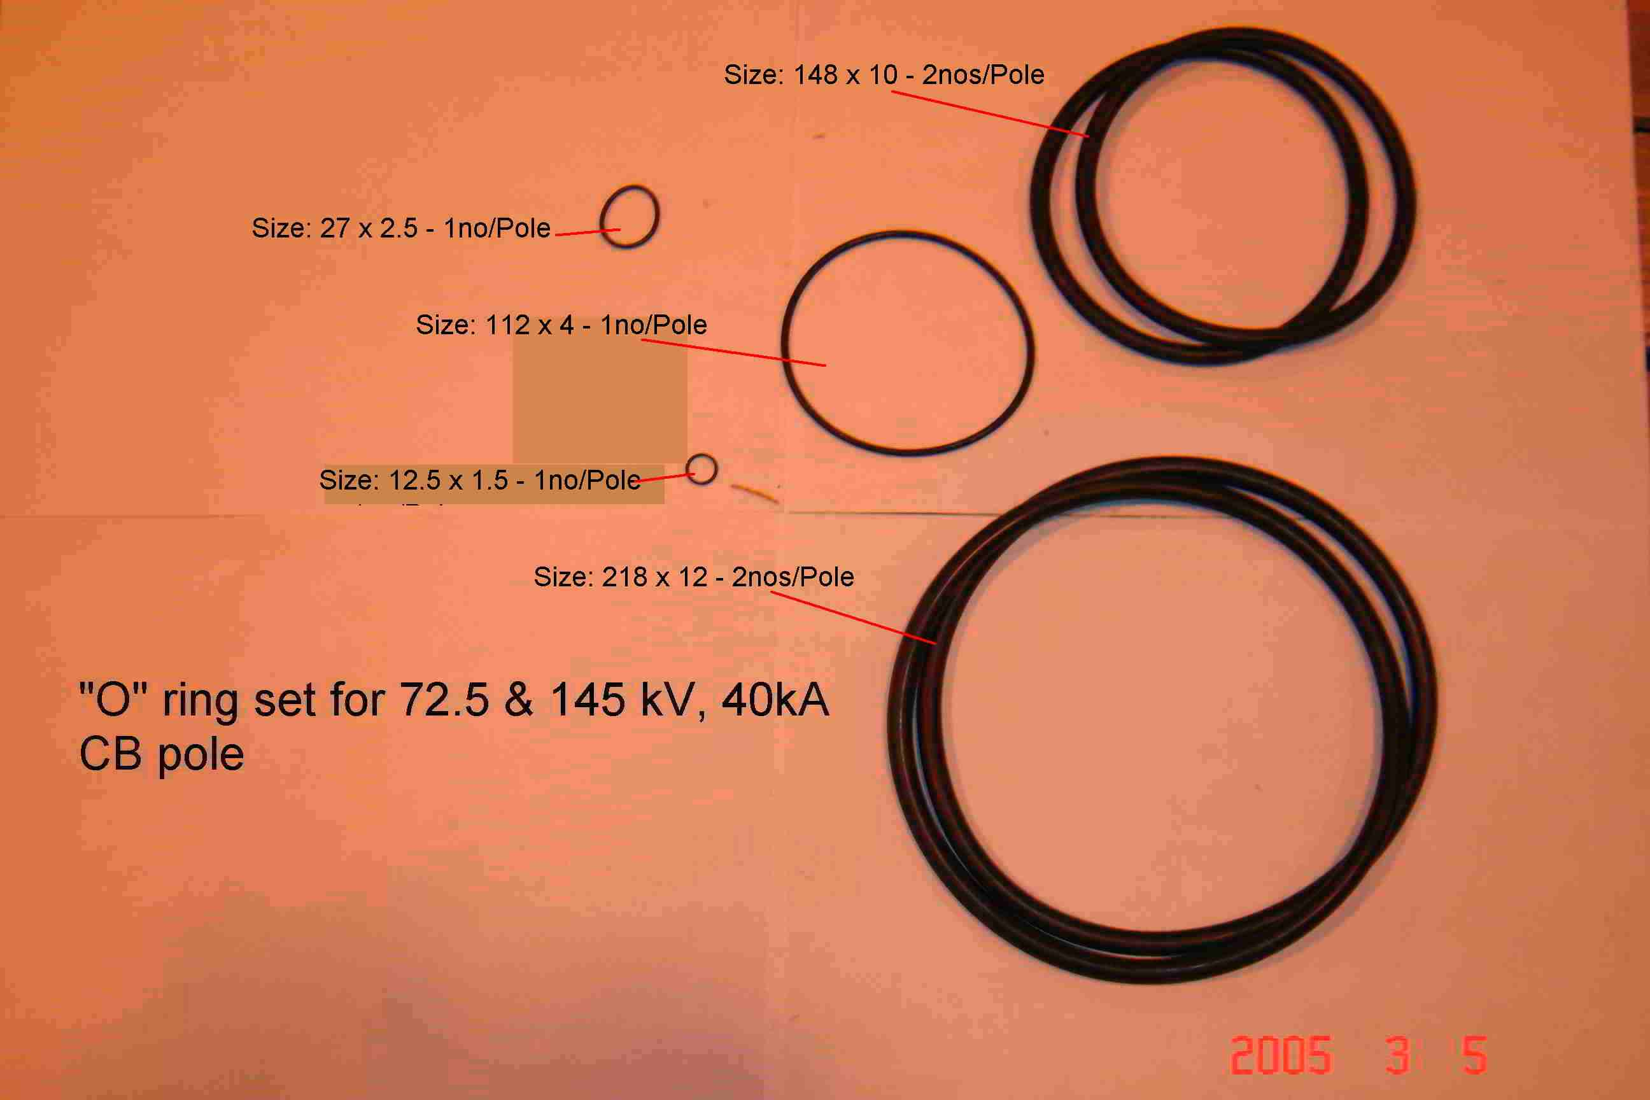
SIEMENS
HVCB SPARES
“O” rings set for each pole for 72.5KV & 145KV, 40KA CB
S4799245001

